Slide 1

Public Communication
Utility / DPU Customer Engagement
August 25, 2022

Slide 2
Customer-Focused Communication
The good news: significant improvements over time
  EJ and municipal partnerships
Overcoming trust barriers remains issue
Communication can and must be simplified
Government agencies, not just EDCs & LDCs, have a role and should be the #1 most accessible part(ies)

Slide 3
Current Methods
Flyers
Bill Inserts
Emails
Municipal Partnerships
Post-Energy Audit Surveys - Consultants

Slide 4


Bill Insert

Slide 5
Barriers: Trust, Language, Competing Priorities for Customers’ Attention
Language: Thanks to work of groups like Green Justice Coalition, GreenRoots, CLF, others, significant language access improvements over time in written material / telephone.
Customer-Focused Surveys - Non-English Speakers Energy Audit: continue to deploy strategies to gather data on successful completion as well as barriers to participation

Slide 6
What’s Missing? What’s May be Creating Problems?
Missing: Independent Voice - DPU lacks public engagement tools deployed by other public utility commissions.
DPU should maintain simple email subscription lists
DPU should require plain English summaries of proceedings that explain to a lay reader the gist
Present: Dreading the Bills - There are inherent limits to bill inserts or communications from any party seeking to collect funds
Brand > Brain? Ratepayer-funded communication must achieve positive impacts for customers, not just corporate branding

Slide 7
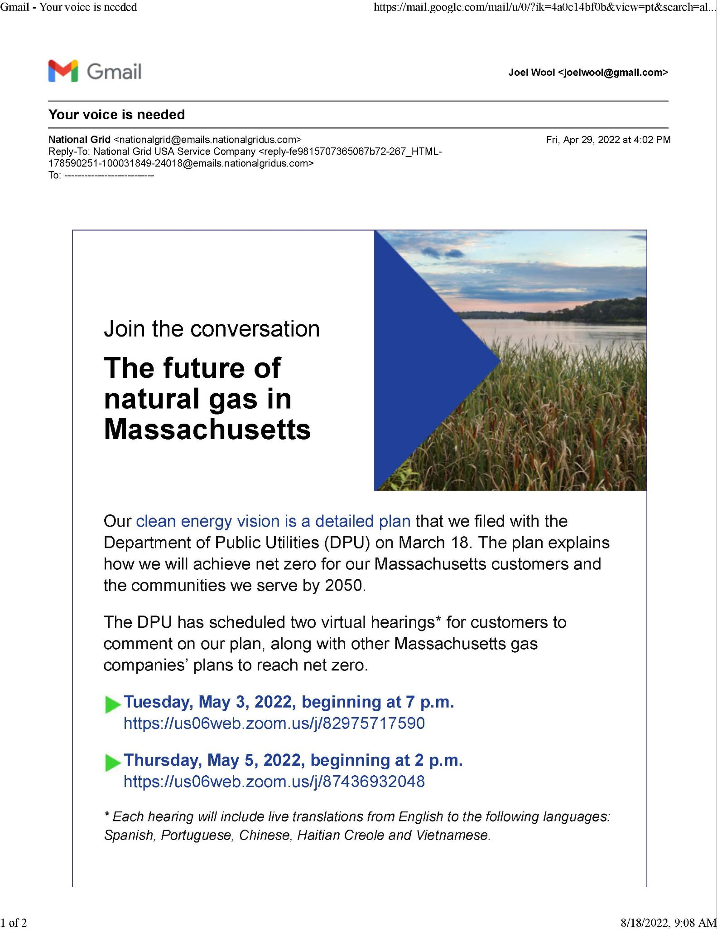
Utilities issue rare, mass email about DPU proceedings concerning Future of Gas proceeding -
where is the engagement over rate cases? efficiency?

Slide 8
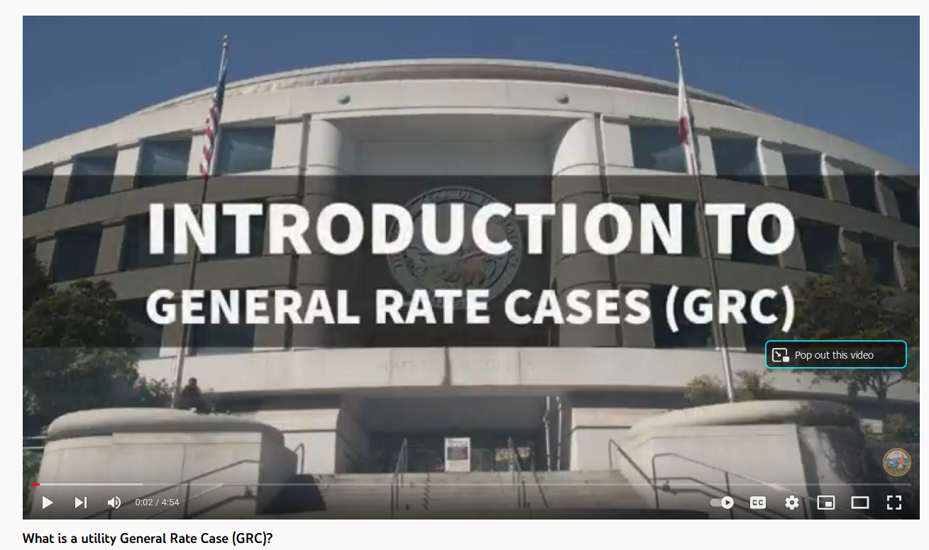

Slide 9
In Summary
Progress is happening
DPU should ensure ratepayer communications are effective, not self-interested
Utilities can do better, government must also do more

